Slide 1


Marga Vancells
11th March 2022

Slide 2

Outline
Executive Summary
Introduction
Methodology
Results
Conclusion
Appendix

Slide 3
Executive Summary
Summary of methodologies
Data Collection API
Data Collection with Web Scraping
Data Wrangling
Exploratory data analysis (EDA) with SQL
Exploratory data analysis (EDA) with Visualization
Data Visualization with Folium
Interactive Dashboard with Ploty Dash
Predictive Analysis (Classification)
Summary of all results
Data analysis results
Predictive Analysis results

Slide 4
Introduction
Project background and context
SpaceX advertises Falcon 9 rocket launches on its website with a cost of 62 million dollars; other providers cost upward of 165 million dollars each, much of the savings is because SpaceX can reuse the first stage.
Therefore if we can determine if the first stage will land, we can determine the cost of a launch. This information can be used if an alternate company wants to bid against SpaceX for a rocket launch.
The goal of the projects is to predict if the Falcon 9 first stage will land successfully.
Problems we want to find answers
Which features influence a successful landing?
Which is the best model to predict a successful landing?

Slide 5

Section 1

Slide 6
Methodology
Executive Summary
Data collection methodology:
Requests to the SpaceX API
Web scraping from a Wikipedia page
Perform data wrangling
Create a classification variable from a categorical column
Perform exploratory data analysis (EDA) using visualization and SQL
Perform interactive visual analytics using Folium and Plotly Dash
Perform predictive analysis using classification models
How to build, tune, evaluate classification models

Slide 7
Data Collection
Request rocket launch data from
SpaceX API (via get request)
Wikipedia webpage (via webscrapping)
Decode the response content and turn it into a Pandas dataframe
Filter out not needed launches
Export to a CSV file

Slide 8
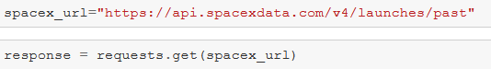
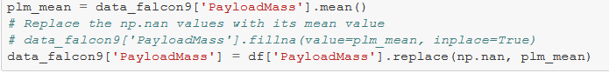
Data Collection – SpaceX API
Request data from SpaceX API
Decode the response into a Pandas
dataframe
Filter the dataframe
Deal with missing values
Export to CSV

Slide 9
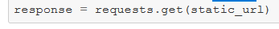
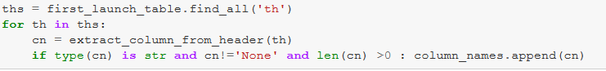
Data Collection - Scraping
Create a BeautifulSoup object from the HTML response
Find all tables
Create a data frame by parsing
the HTML tables
Export to CSV
Request the Falcon9 Launch Wikipedia page
Get column names

Slide 10
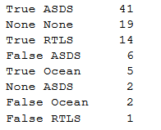
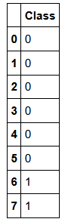
Data Wrangling
Calculate the number of launches for each site.
Calculate the number and occurrence of each orbit
Calculate the number and occurence of mission outcome per orbit type
Create a landing outcome label from Outcome column.
There are several different cases where the booster did not land successfully. Sometimes a landing was attempted but failed due to an accident.
We will mainly convert those outcomes into Training Labels with 1 means the booster successfully landed 0 means it was unsuccessful.

Slide 11
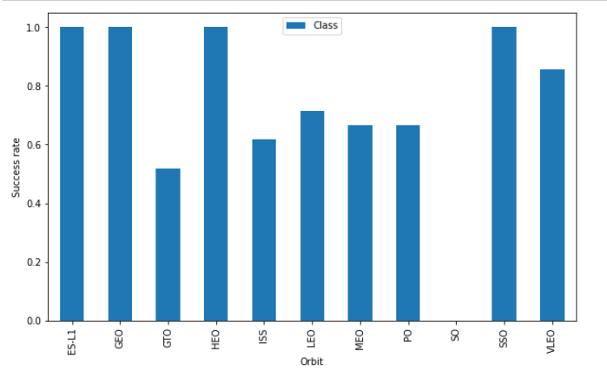
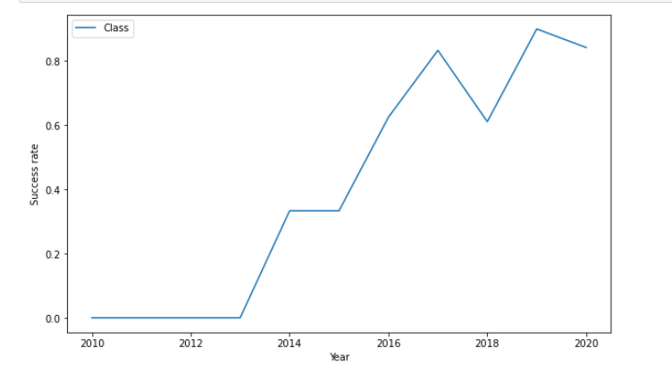
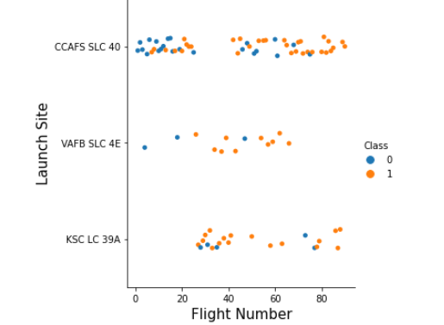
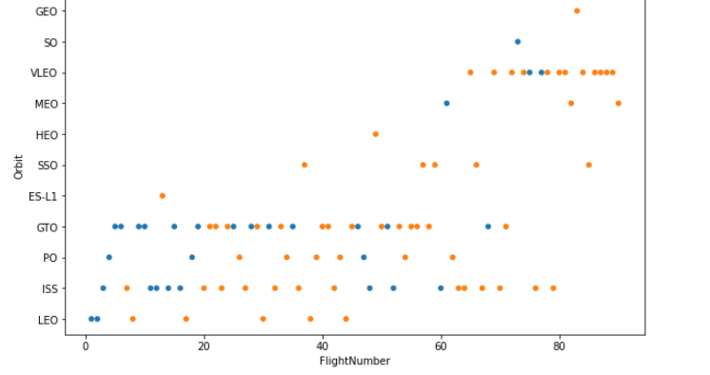
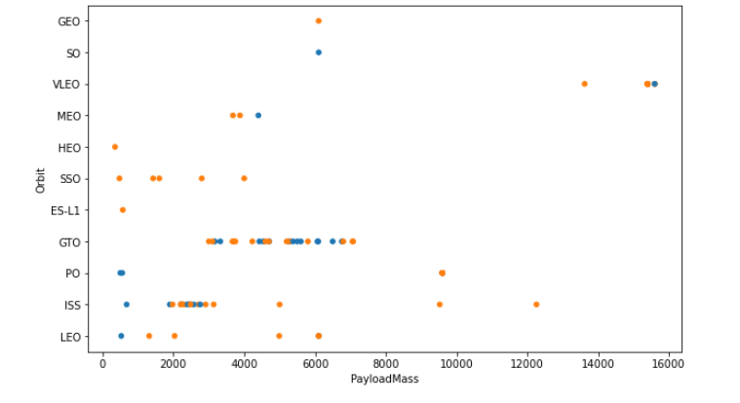
EDA with Data Visualization
Scatter charts
FlightNumber vs PayloadMass
FlightNumber vs LaunchSite
Payload vs Launch Site
FlightNumber vs Orbit type
Payload vs Orbit type
Bar charts
sucess rate of each orbit
Line charts
success yearly trend

Slide 12
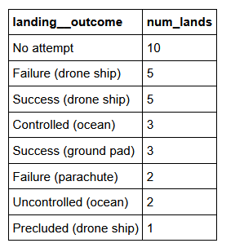
EDA with SQL
Store the dataset in database table
Write and execute SQL queries to do EDA:
Display the names of the unique launch sites in the space mission
Display 5 records where launch sites begin with the string 'CCA’
Display the total payload mass carried by boosters launched by NASA (CRS)
Display average payload mass carried by booster version F9 v1.1
List the date when the first successful landing outcome in ground pad was achieved
List the names of the boosters which have success in drone ship and have payload mass greater than 4000 but less than 6000
List the total number of successful and failure mission outcomes
List the names of the booster_versions which have carried the maximum payload mass. Use a subquery
List the failed landing_outcomes in drone ship, their booster versions, and launch site names for in year 2015
Rank the count of landing outcomes (such as Failure (drone ship) or Success (ground pad)) between the date 2010-06-04 and 2017-03-20, in descending order

Slide 13
Build an Interactive Map with Folium
The launch success may also depend on the location and proximities of a launch site, i.e., the initial position of rocket trajectories.
Finding an optimal location for building a launch site certainly involves many factors, and hopefully, we could discover some of the factors by analyzing the existing launch site locations.
Map Object | Use
Circle | To add a highlighted circle area with a text label on a specific coordinate
Marker | To make a mark on the map
Marker Cluster | To simplify the map containing many markers having the same coordinate
Mouse Position | To obtained a coordinate of a point
Poly Line | To draw a line between a launch site to the selected coastline point

Slide 14
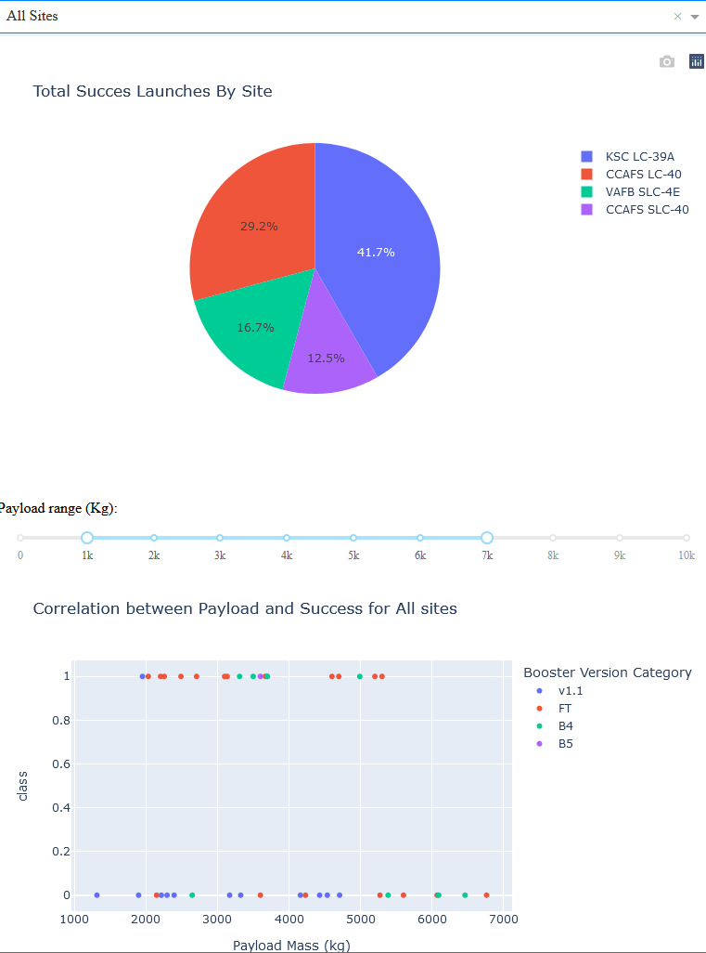
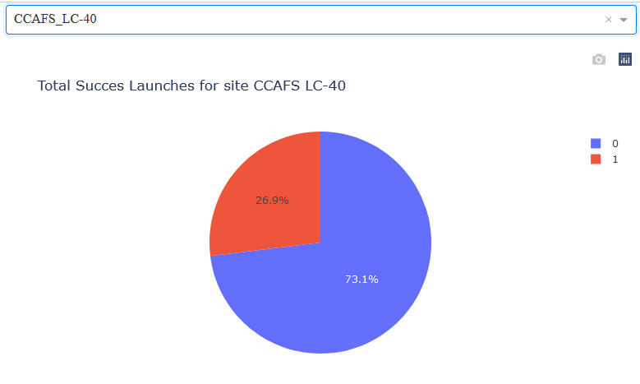
Build a Dashboard with Plotly Dash
We build a dashboard with these objects
A launch site drop-down list
A success pie chart based on the selected site drop-down
A range slider to select Payload
A success payload scatter plot based on the selected site drop-down and the selected Payload range
With the dashboard we could analyze SpaceX launch data and answer some questions

Slide 15
Predictive Analysis (Classification)
Repeat the same process with:
Support vector machine
decision tree classifier
k nearest neighbours
Load the data
Transform to a NumPy array
Standardize and transform the data
Split the data into training and testing sets
Create a logistic regression object
Fit the object to find the best parameters on validation data
Calculate the accuracy on the validation data
Check confusion matrix
Calculate the accuracy on the test data
Select the best model
(best accuracy)

Slide 16
Results
Exploratory data analysis results
Interactive analytics demo in screenshots
Predictive analysis results

Slide 17

Section 2

Slide 18
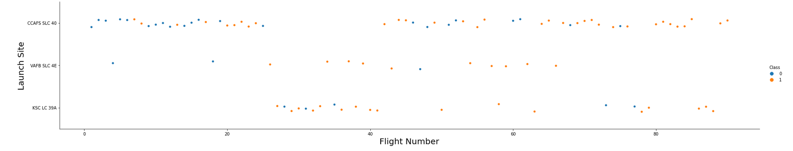
Flight Number vs. Launch Site
With more amount of flights, the success rate increases for each site

Slide 19
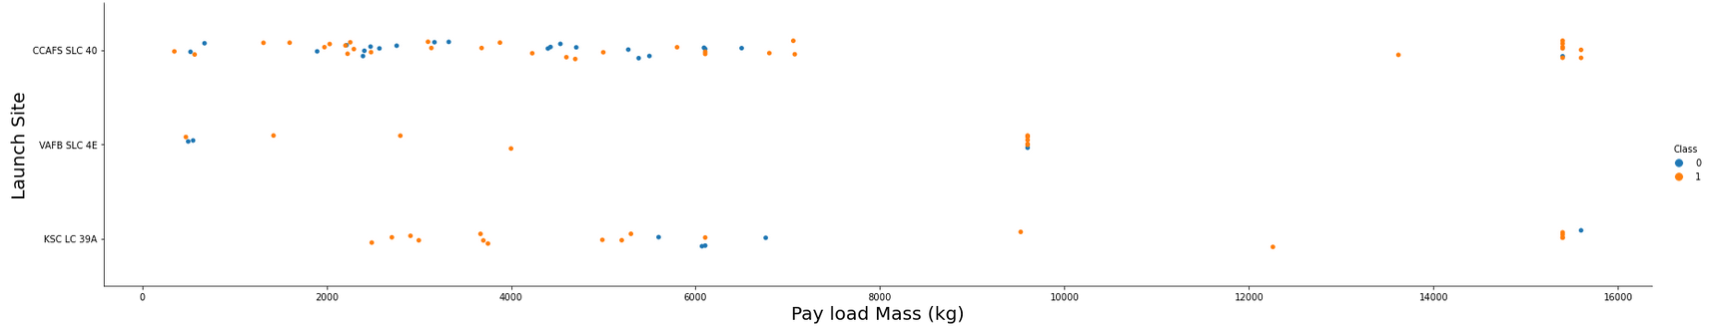
Payload vs. Launch Site
For the VAFB-SLC-4E launch site, there are no rockets launched for heavy payload mass (greater than 10000)
For CCAFS-SLC-40, the greater the payload mass, the higher the success rate

Slide 20
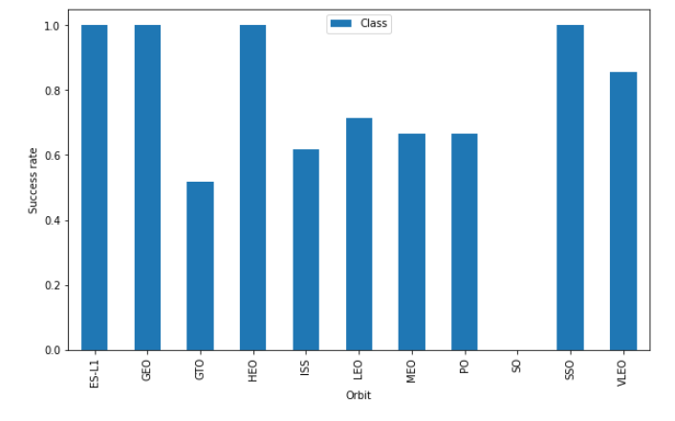
Success Rate vs. Orbit Type
ES-L1, GEO, HEO and SSO orbits have the best success rates

Slide 21
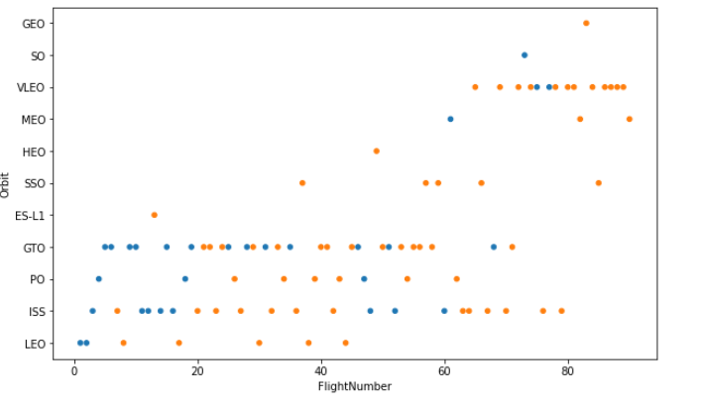
Flight Number vs. Orbit Type
In the LEO orbit, the Success appears related to the number of flights
In GTO orbit, there seems to be no relationship between flight number

Slide 22
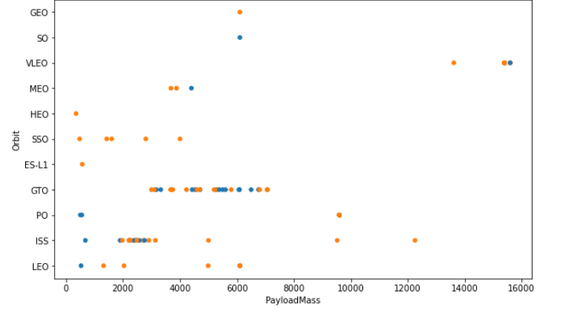
Payload vs. Orbit Type
With heavy payloads, the successful landing or positive landing rate is more for Polar, LEO and ISS
For GTO, we cannot distinguish this well as both positive landing rate and negative landing

Slide 23
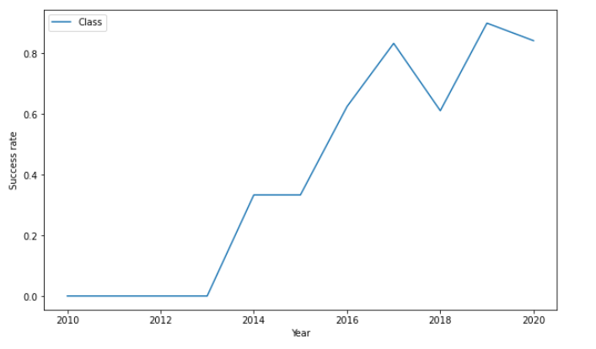
Launch Success Yearly Trend
The success rate since 2013 kept increasing till 2020

Slide 24
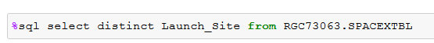
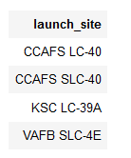
All Launch Site Names
Using the word DISTINCT we get only unique values

Slide 25
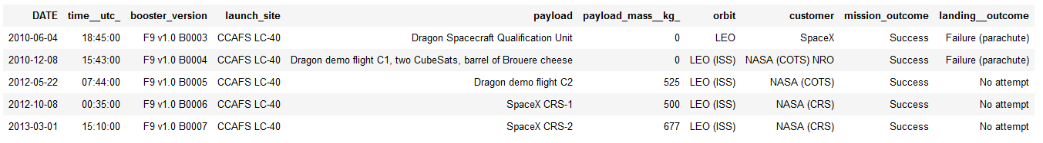
Launch Site Names Begin with 'CCA'
With LIKE and CCA%, we get the ones that begin with CCA
With LIMIT 5, we get only 5 records

Slide 26
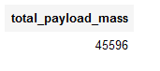
Total Payload Mass
With the SUM, function we calculate the total payload mass
With the filter in the WHERE clause, we calculated only over ‘NASA (CRS)’ customers

Slide 27
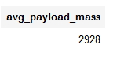
Average Payload Mass by F9 v1.1
With the AVG function, we calculate the average payload mass
With the filter in the WHERE clause, we calculate only over the booster version F9 v1.1

Slide 28
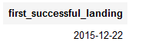
First Successful Ground Landing Date
With the MIN function, we get the first date
With the filter in the WHERE clause, we get it only over successful landing outcome on ground pad

Slide 29
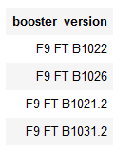
Successful Drone Ship Landing with Payload between 4000 and 6000
With the filter in the WHERE clause, we get only the boosters that have successfully landed on a drone ship and had payload mass greater than 4000 but less than 6000

Slide 30
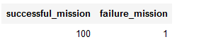
Total Number of Successful and Failure Mission Outcomes
For successful_mission, with the CASE clause, we indicate 1 if outcome begins with ‘Success’ and 0 otherwise, and then we SUM it
For failure_mission, we do the same but with the outcome beginning with ‘Failure’

Slide 31
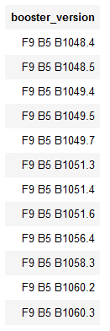
Boosters Carried Maximum Payload
First, we get the maximum payload mass with the MAX function
Then we filter the query with the max value returned with the subquery

Slide 32
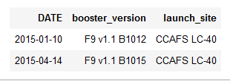
2015 Launch Records
We get only 2015 with the EXTRACT(YEAR FROM [date]) function

Slide 33
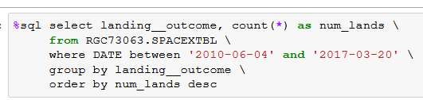
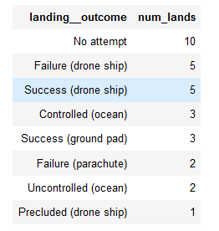
Rank Landing Outcomes Between 2010-06-04 and 2017-03-20
With the COUNT, function we get the number of records
With GROUP BY, we apply the count function to each landing outcome
With ORDER BY DESC, we list them in descending order

Slide 34

Section 3

Slide 35
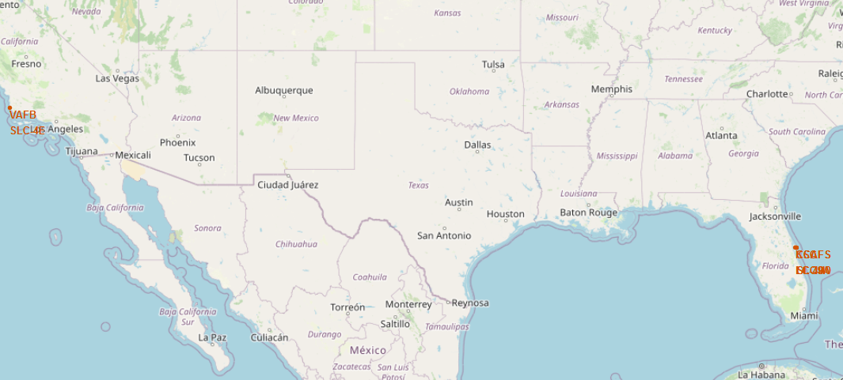
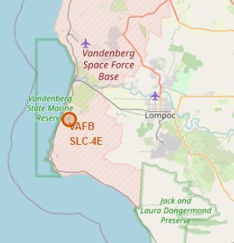
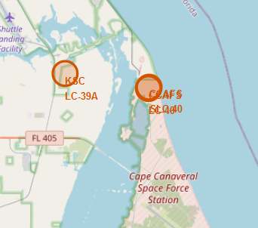
All launch sites on a map
All launch sites are in very close proximity to the coast
All launch sites are in proximity to the Equator line

Slide 36
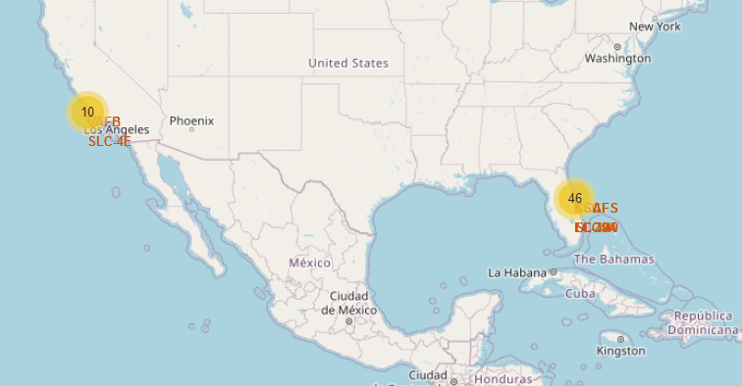
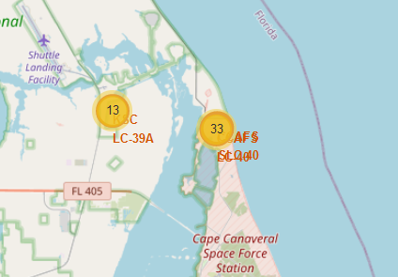
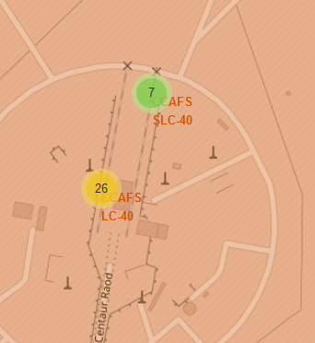
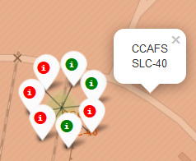
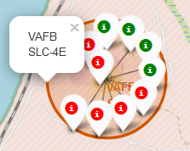
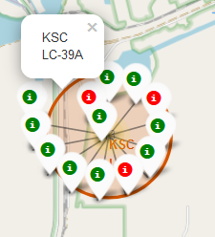
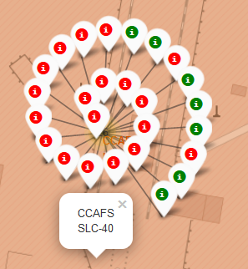
Color-labeled launch on the map
From the color-labelled markers, we can identify that launch site KSC LC-39A has relatively high success rates
Green marker: Successful
Red marker: Failure

Slide 37
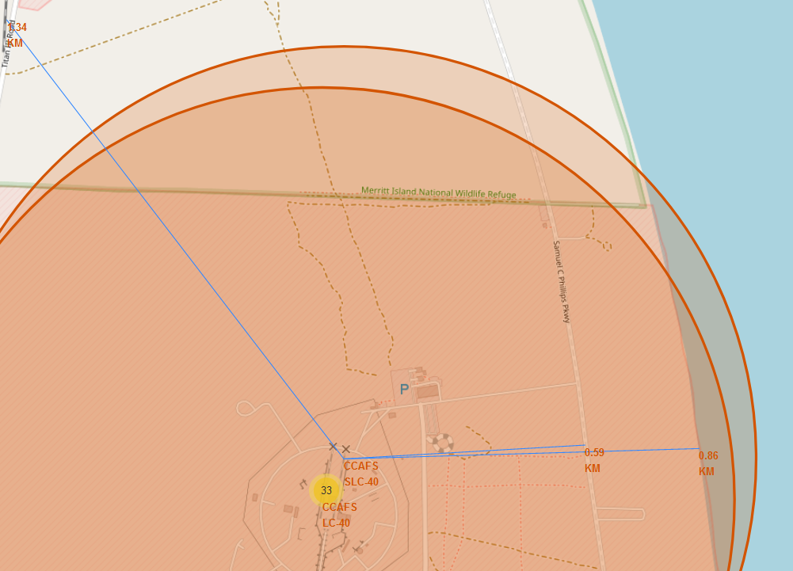
Launch Site distances
Launch Site CCAFS SLC-40 is not far away from the railway, highway and coastline

Slide 38

Section 4

Slide 39
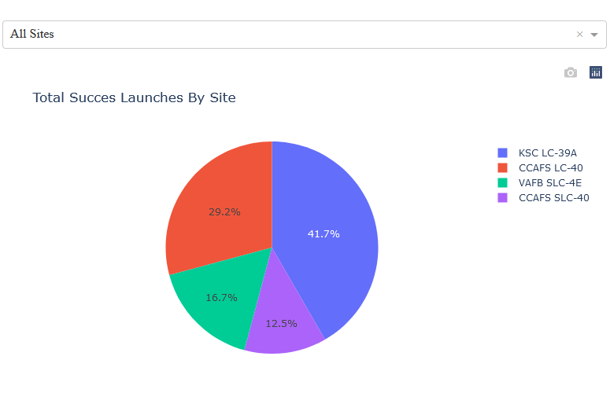
Total Success Launches by Site
KSC LC-39A launch site has the most success launch rate

Slide 40
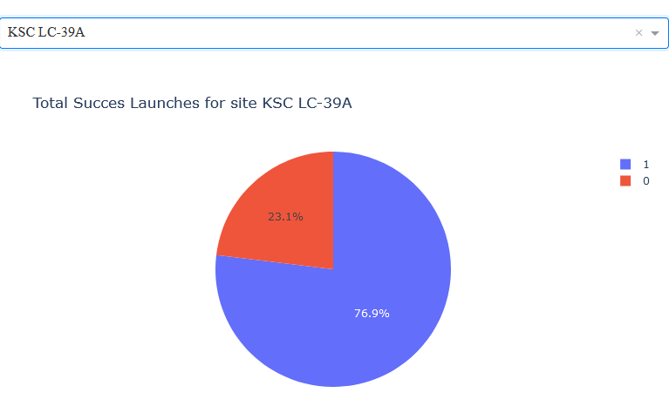
Launch site with highest launch success ratio
KSC LC-39A has a 76,9% success rate and a 23.1% failure rate

Slide 41
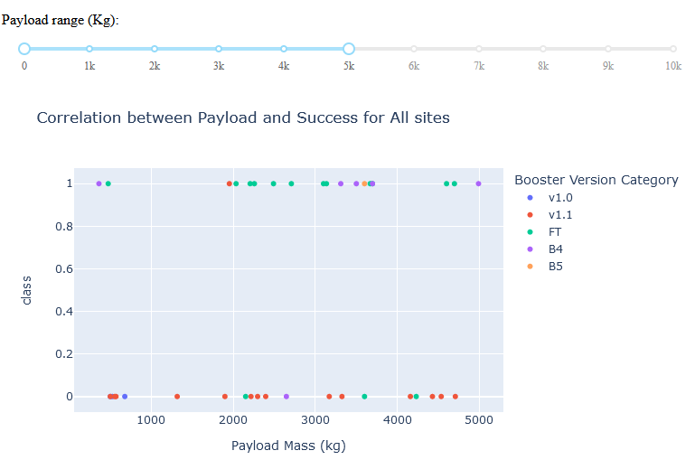
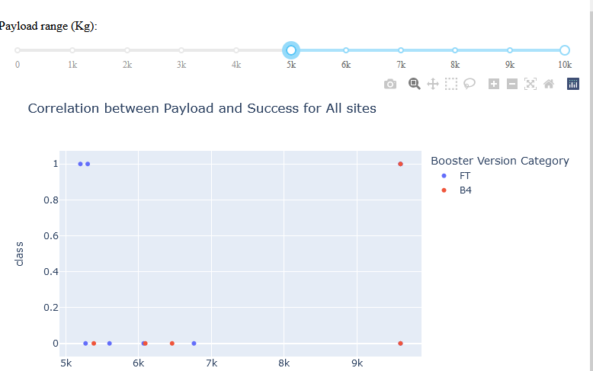
Payload vs. Launch Outcome plot for all sites
The success rate is higher for low weighted payloads

Slide 42

Section 5

Slide 43
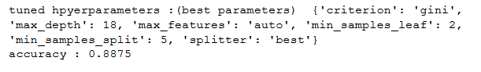
Classification Accuracy
Algorithm | Accuracy | Accuracy on test data
Logistic Regression | 0.8464285714285713 | 0.8333333333333334
Support Vector Machine | 0.8482142857142856 | 0.8333333333333334
Decision Tree classifier | 0.8875 | 0.8333333333333334
K nearest neighbors | 0.8482142857142858 | 0.8333333333333334
The decision tree classifier is the model with the highest classification accuracy, with these parameters:

Slide 44
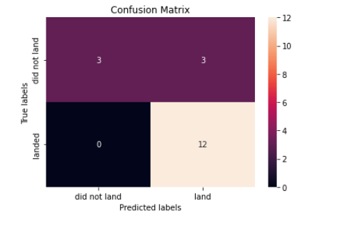
Confusion Matrix
The decision tree classifier can distinguish between the different classes. We see that the major problem is false positives.

Slide 45
Conclusions
With more amount of flights, the success rate increases for each site
ES-L1, GEO, HEO and SSO orbits have the best success rates
The success rate has been increasing son 2013
KSC LC-39A has the most success launch rate
The success rate is higher for low weighted payloads
The decision tree classifier is the model with the highest classification accuracy

Slide 46


